Slide 1

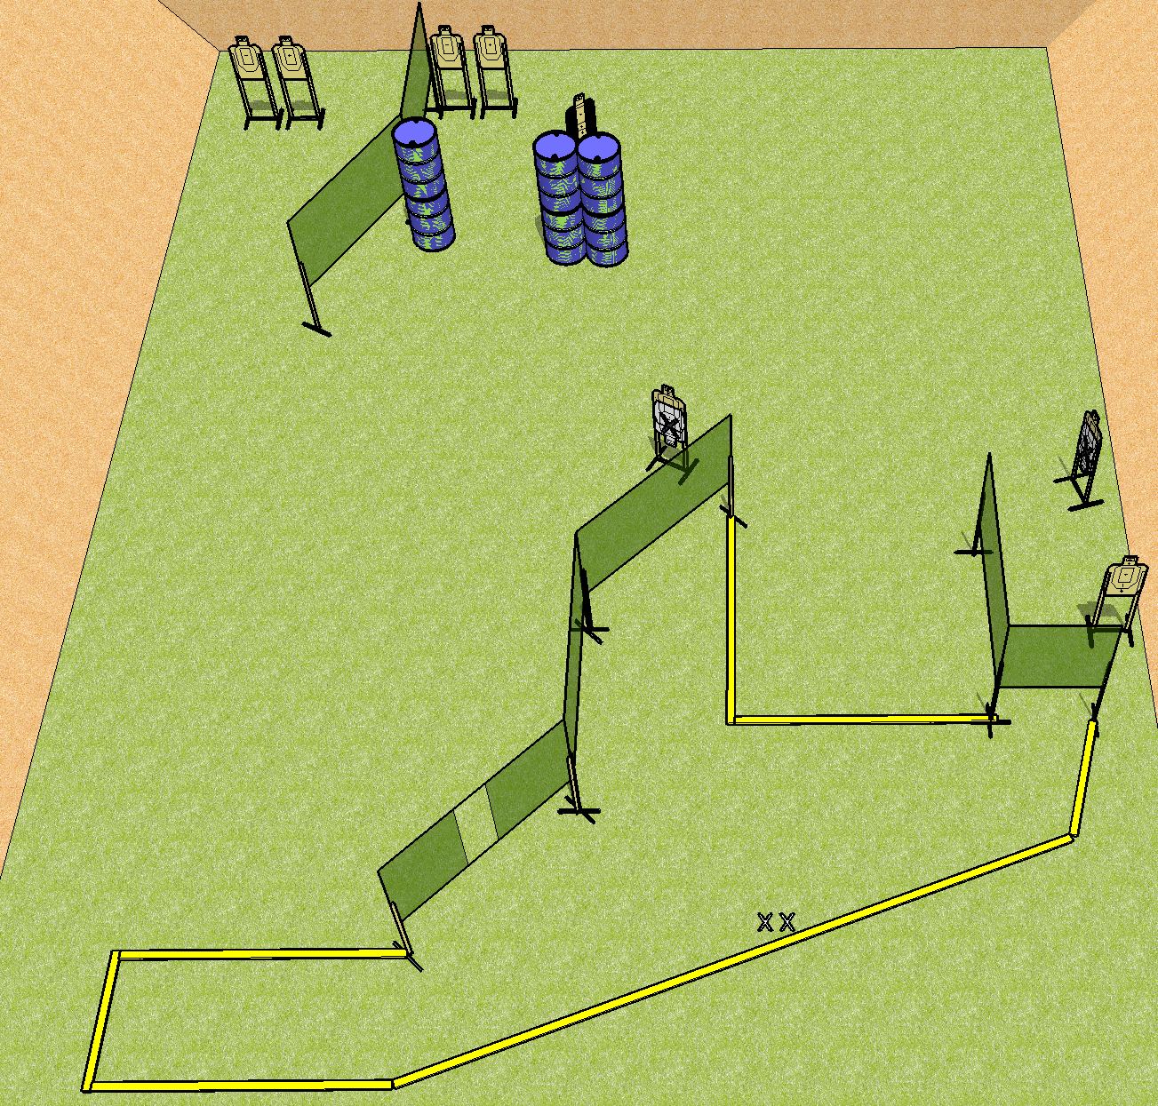
 | Dothan Practical Shooters – USPSA Match Calling All Angles Course Designer : Drew Coleman Bay: B1
Round Count 16 rounds 8 USPSA
Equipment List 13 wall feet 1 tux 9 targets (7 + 2NS)

Slide 2
Calling All Angles
Written Stage Briefing
Scoring: Comstock Rounds: 18
Targets: 9 USPSA
Handgun start position: feet on X’s, wrists below belt. Handgun is UNLOADED and holstered.
PCC start position: feet on X’s. UNLOADED carbine held with both hands, stock on belt
(unloaded = no magazine, empty chamber, hammer down)
Stage Procedure: on the audible start signal, engage targets as they become available from within the shooting area.

